Slide 1

SESAME’s Control System Status
SESAME
Fall 2014 EPICS Collaboration meeting
22/10/2014
Presented by:
Ibrahim Saleh

Slide 2
What is SESAME?
SESAME
SESAME (Synchrotron-light for Experimental Science and
Applications in the Middle East)
First international 3rd generation Synchrotron Light Source
in the Middle East region
Under construction near Amman (Jordan)
Expected to become operational in 2016

Slide 3
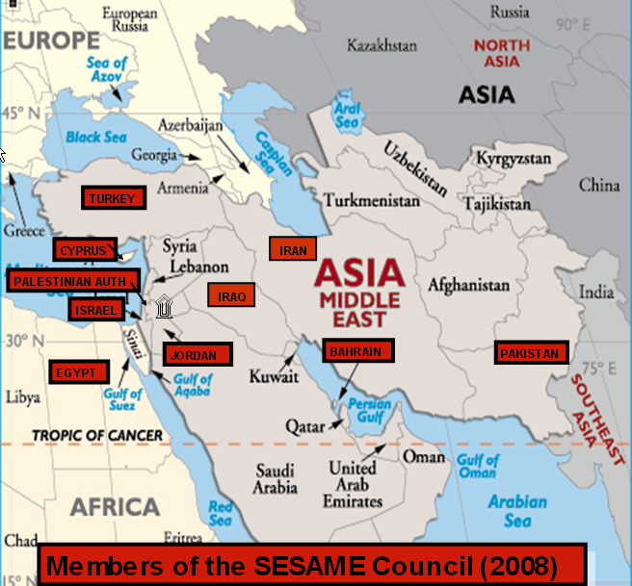
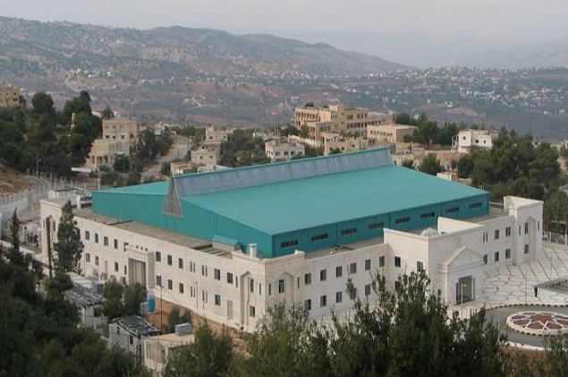
SESAME
SESAME-Members:
Bahrain, Cyprus, Egypt, Israel, Iran,
Jordan, Pakistan, Palestine, Turkey

Slide 4
SESAME
Energy; 2.5 GeV
Circumference; 133m
Emittance; 26 nm-rad
12 Insertion Devices
13 Bend Magnet beam lines
Maximum beam line length; 37m
12 straight sections are available for IDs with lengths up to 3.9 m
Space for future full energy injector in the main ring tunnel
SESAME's injector (Microtron and Booster Ring) have been commissioned
Commissioning of the storage ring is expected in 2016

Slide 5
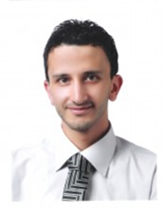
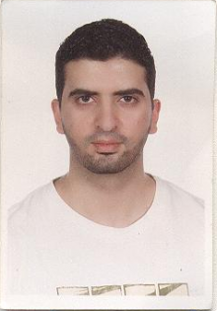

Control Group
SESAME
Ibrahim Saleh Abdallah Ismail Yazan Dabain

Slide 6
Control System Status
SESAME
Outline:
Overview
Infrastructure
Booster Control System
IOCs Development
Clients Development
Archive System
Alarm Handler
Future Work

Slide 7

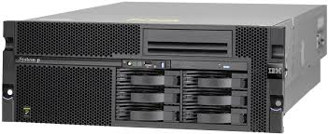
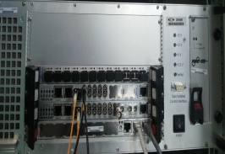
Overview
SESAME
Control System Implementation uses
(EPICS) base 3.14.12
Clients are implemented using a custom
build of Control System Studio (CSS)
based on V.3.16
Servers are implemented as EPICS
Input/Output Controllers (IOCs)
- Soft IOCs (Linux Machines)
- Hard IOCs (Libera, VME)

Slide 8
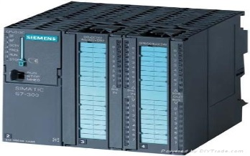
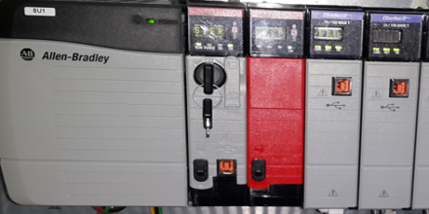


Overview
SESAME
Siemens S7 PLCs are used for the
machine interlocks
Allen Bradley PLC is used for the
Personal Safety System (PSS).
Git version Control System is used
to track development & documentation
Development and administration
platforms use Scientific Linux 6.4

Slide 9
Infrastructure
SESAME
Twelve virtual servers reserved to run the following:
IOCs, Archiver, Alarm Handler, GIT Repository,
Elog server, Bugzilla, Wiki server and File transfer servers
All workstations and servers have been migrated to Scientific Linux 6.4
All clients, servers, and controllers are connected to an isolated machine network.
A version control system is used to track development using
GIT. Separate repositories exist for: IOCs, clients, documentation,
required software packages and CSS

Slide 10
Infrastructure
SESAME
Issues tracking (including bugs and tasks) is done using Bugzilla.
Any group may submit a bug/task for any other group
ELOG is used by operators to write information during the commissioning, which makes it easy for other people to access this information through a Web interface, browse entries, search, download files, and optionally add, update, delete or comment on entries
MediaWiki server has been recently installed. Documents will be transferred to this wiki to enable easy access

Slide 11
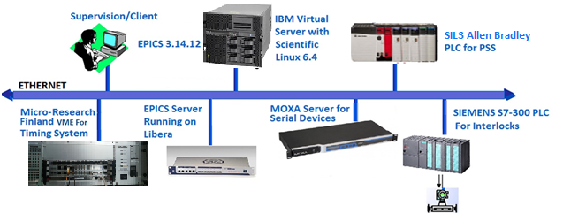
Booster Control System
SESAME
General Architecture
Booster Ring

Slide 12
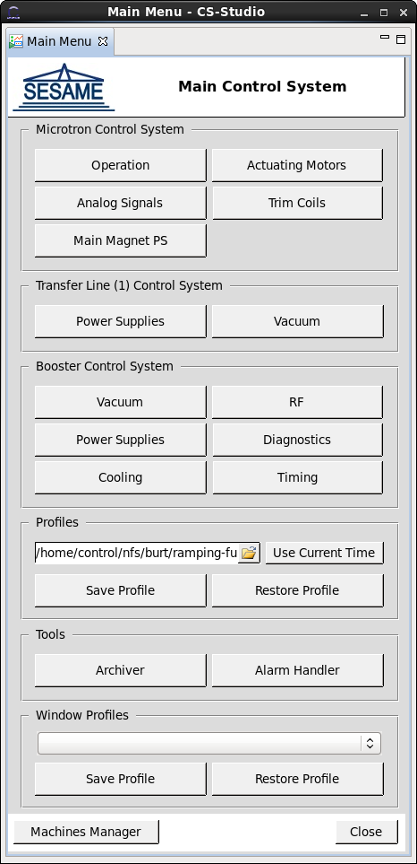
Booster Control System
SESAME
Vacuum
Power Supplies
RF
Diagnostics
Cooling
Timing
PSS
Main CSS OPI

Slide 13
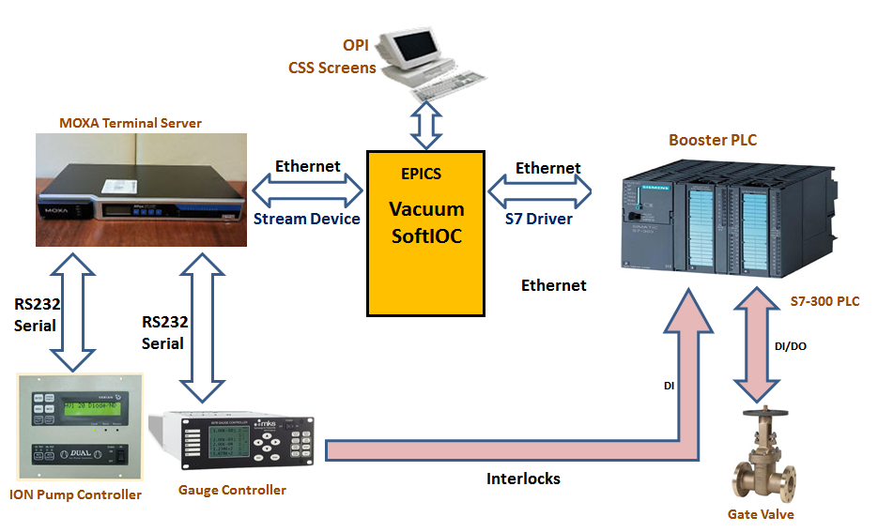
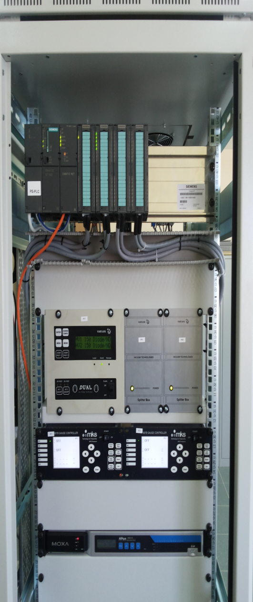
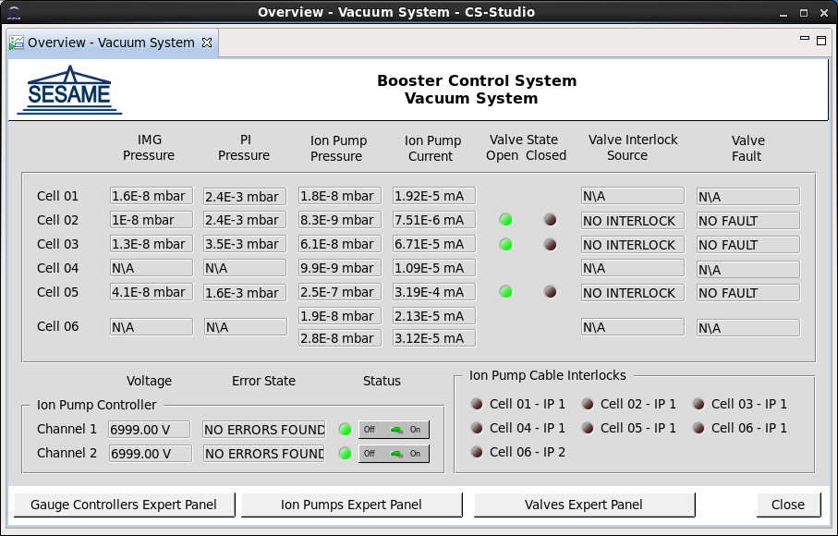
Booster Control System - Vacuum
SESAME
Vacuum Control Architecture
Vacuum Client
Vacuum Main OPI
Vacuum Rack

Slide 14
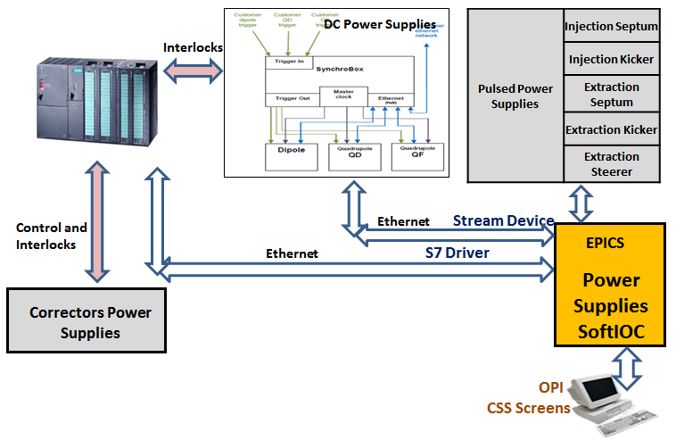
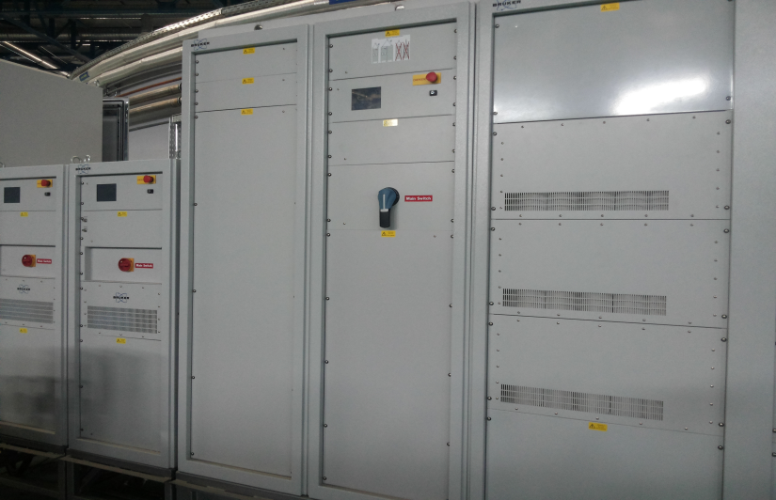
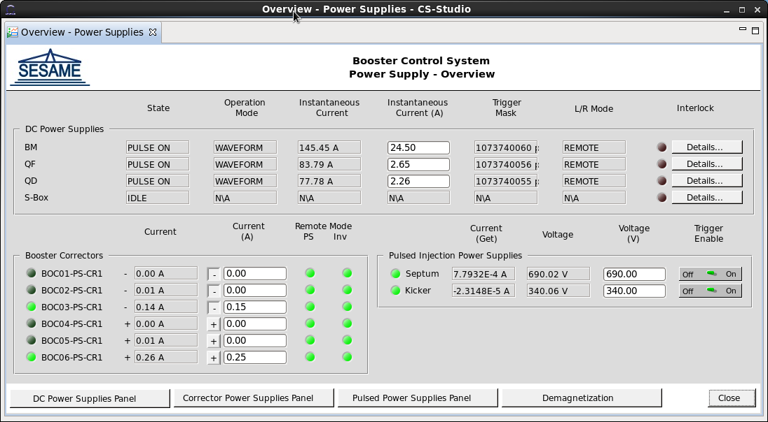
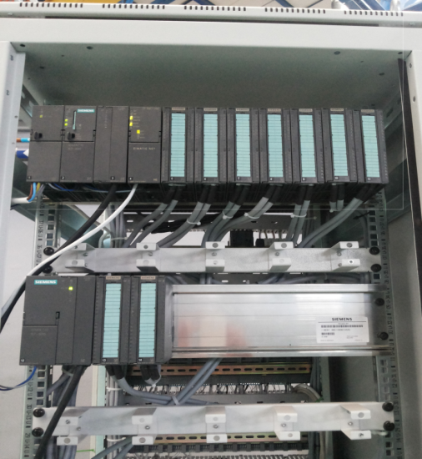
Booster Control System – Power Supplies
SESAME
Power Supplies Control Architecture
DC Power Supplies
Power Supplies Main OPI
Power Supplies PLC

Slide 15
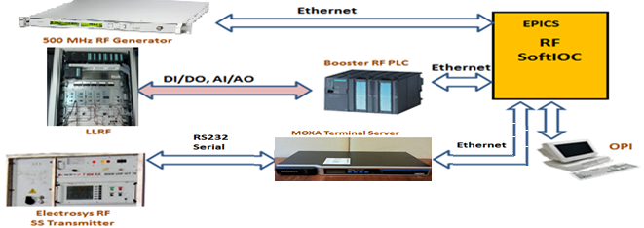
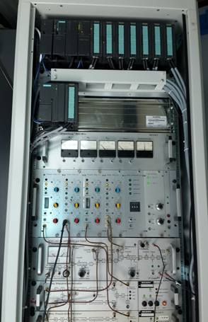
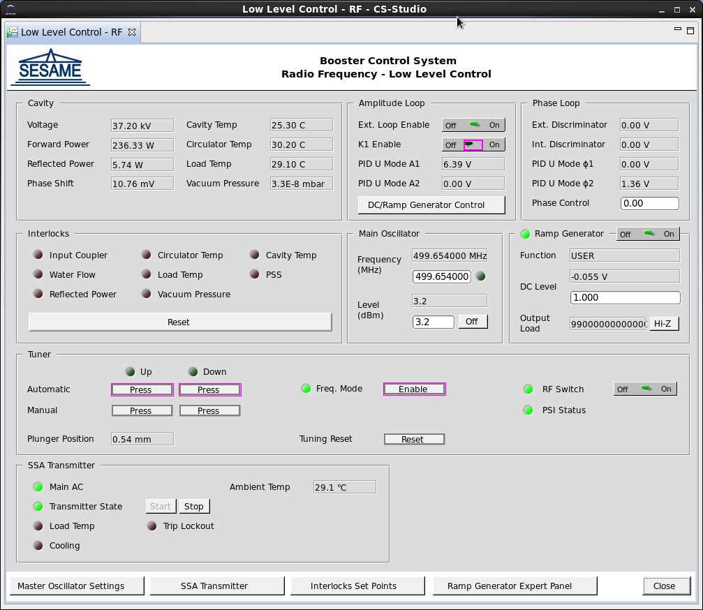
Booster Control System - RF
SESAME
RF Control Architecture
RF Main OPI
LLRF Rack

Slide 16
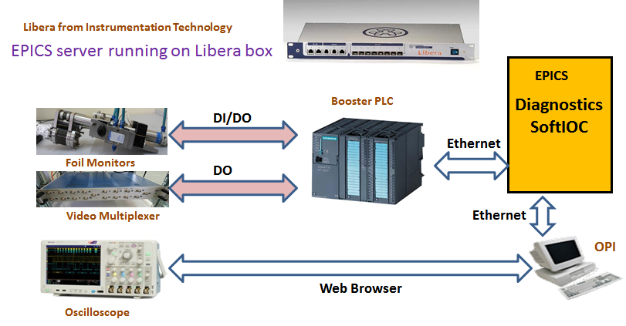
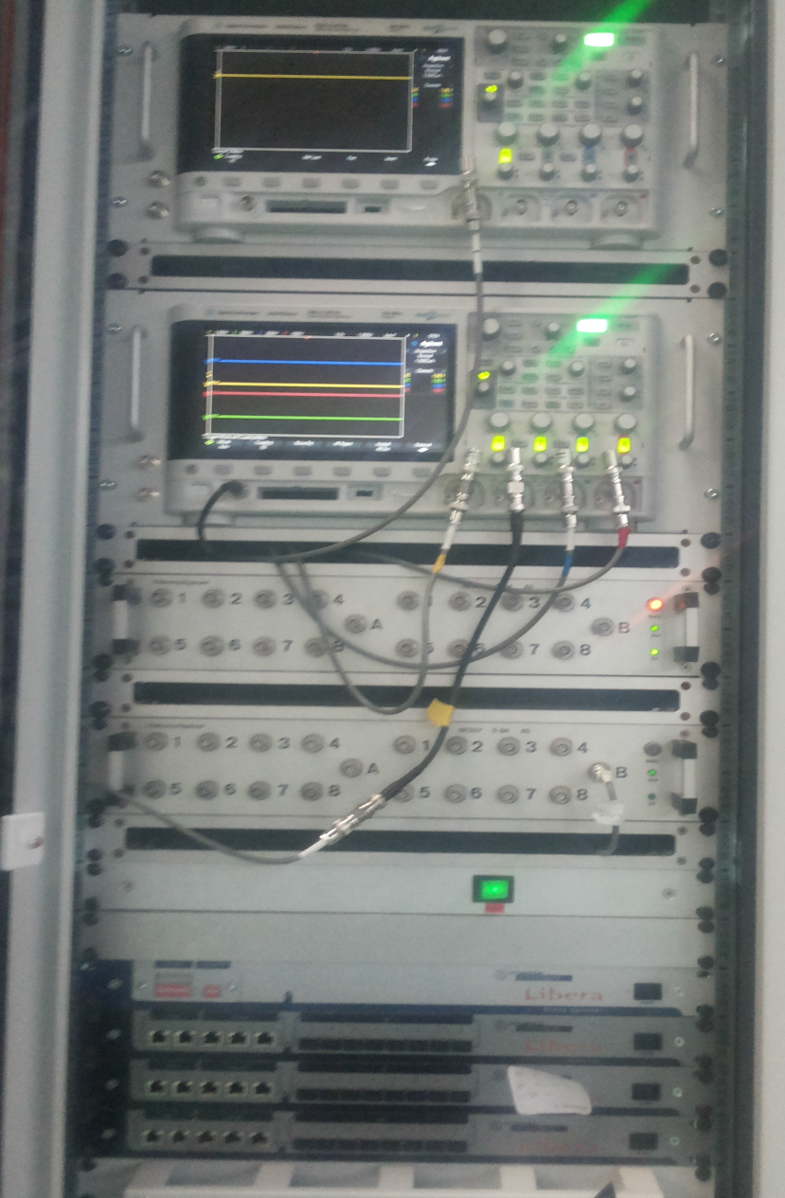
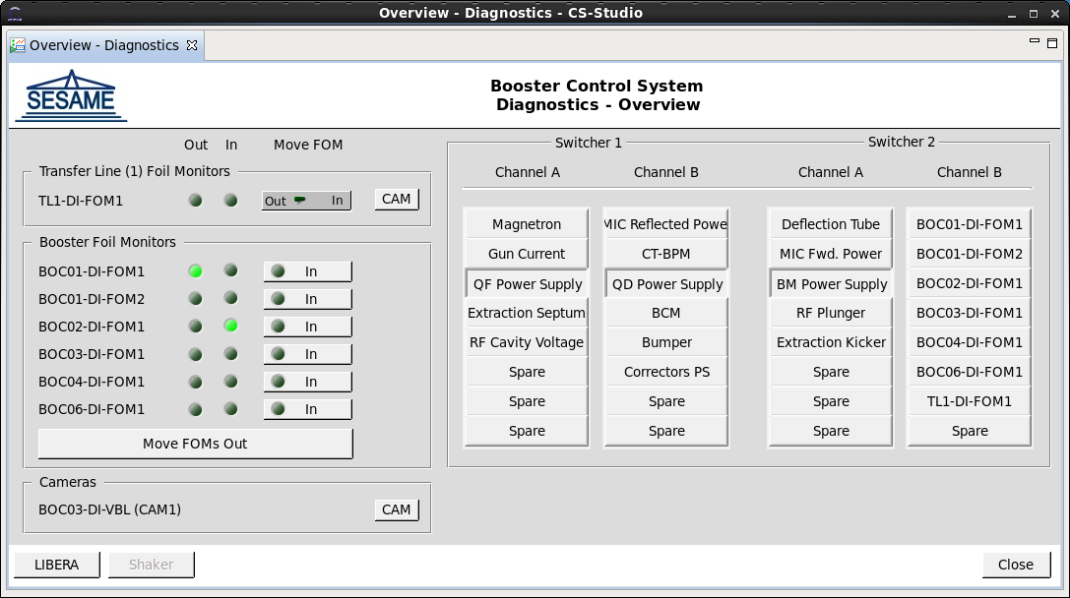
Booster Control System - Diagnostics
SESAME
Diagnostics Control Architecture
Diagnostics Main OPI
Diagnostics Rack

Slide 17
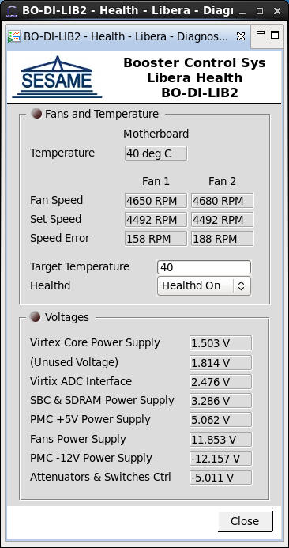
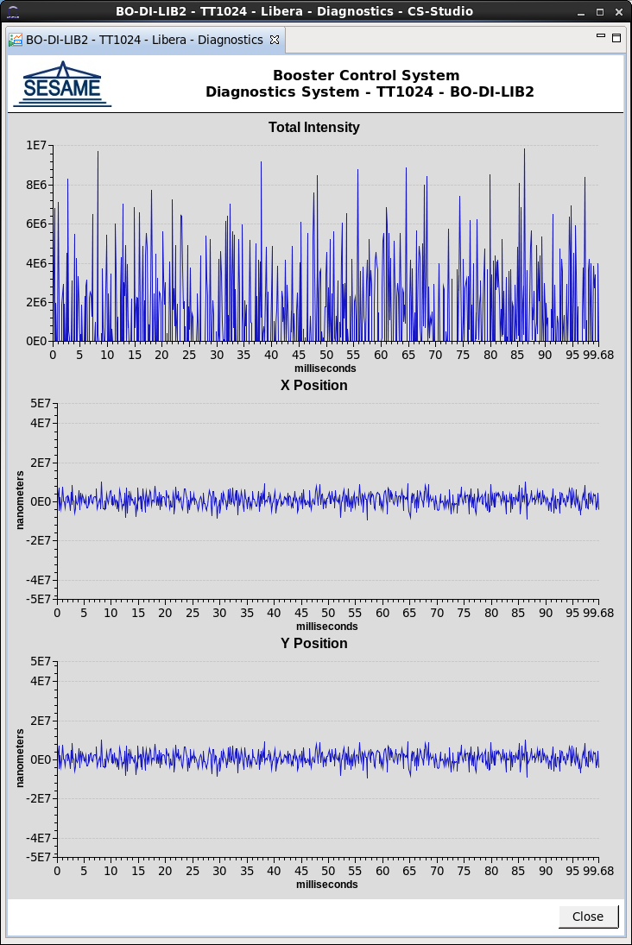
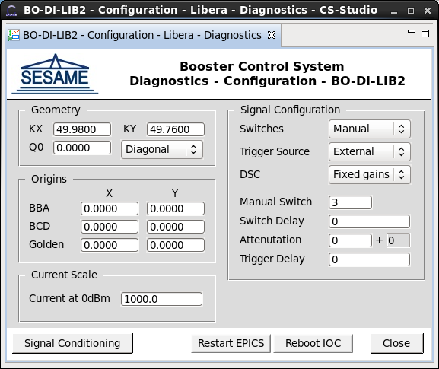
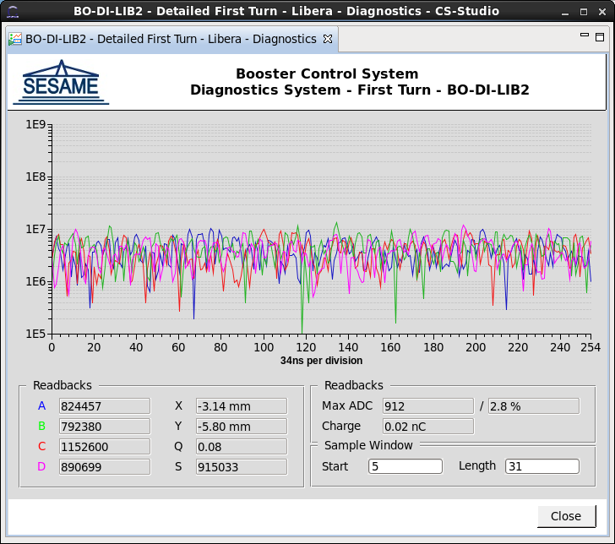
Booster Control System - Diagnostics
SESAME
New CSS Libera Screens
Libera OPIs

Slide 18
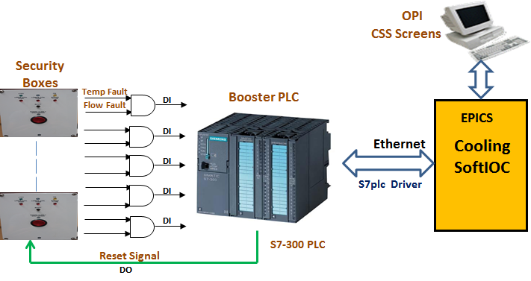
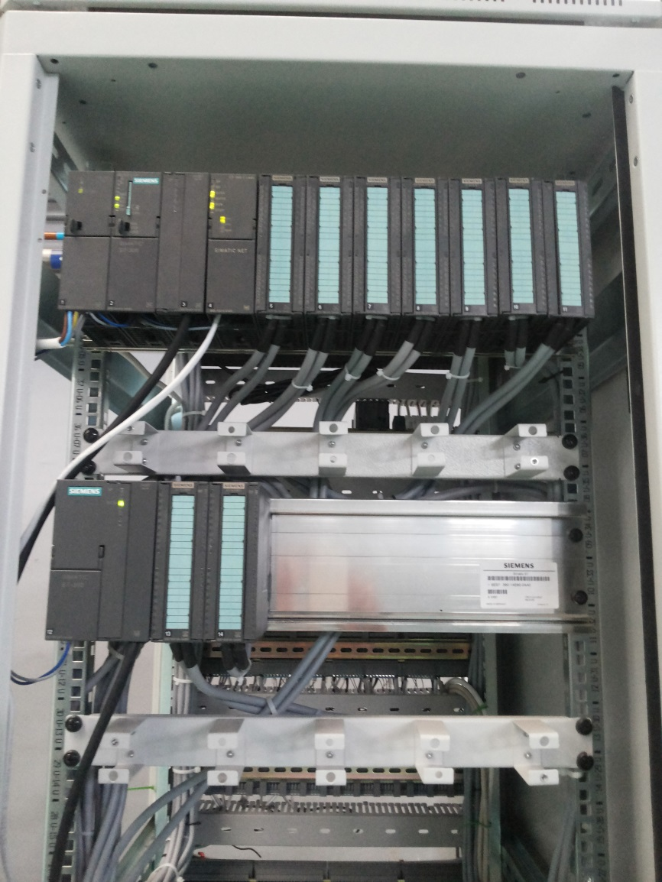
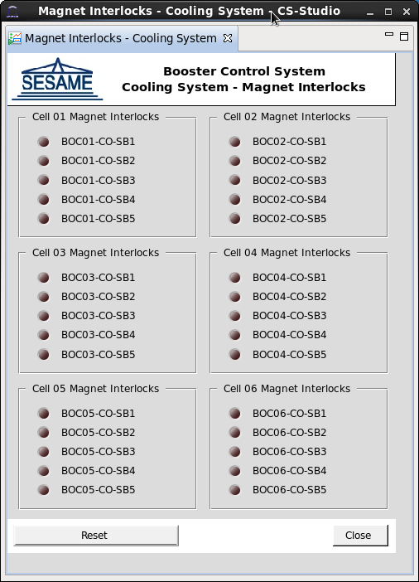
Booster Control System - Cooling
SESAME
Cooling Control Architecture
Cooling Main OPI
Cooling Rack

Slide 19
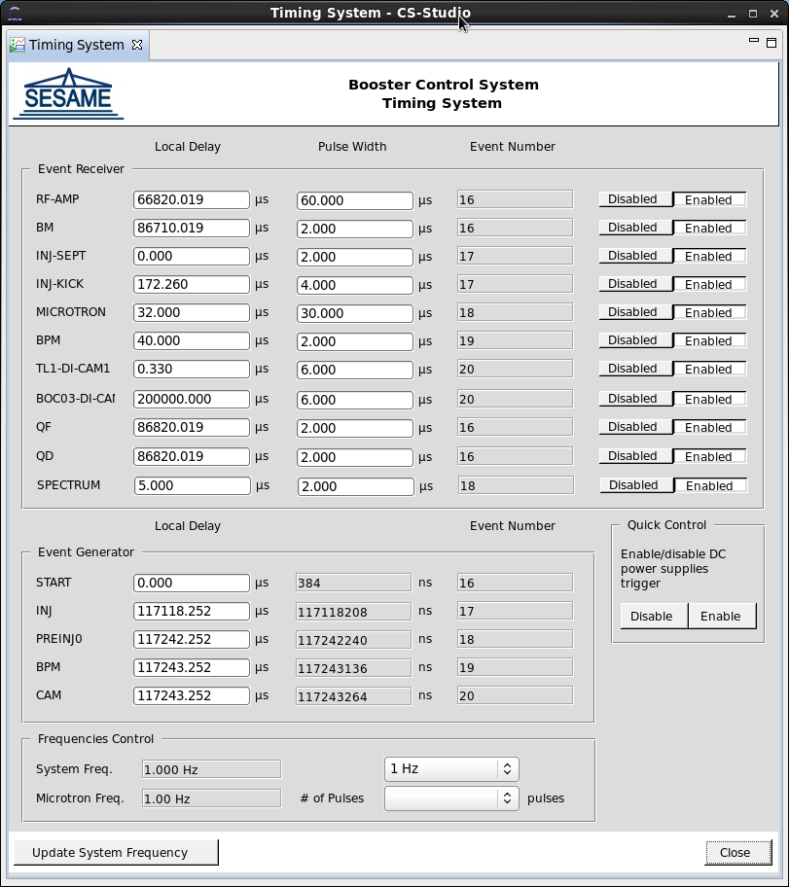
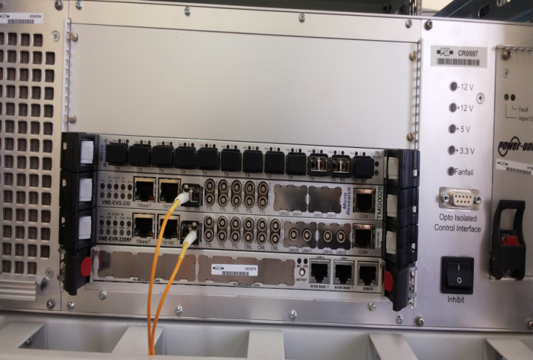
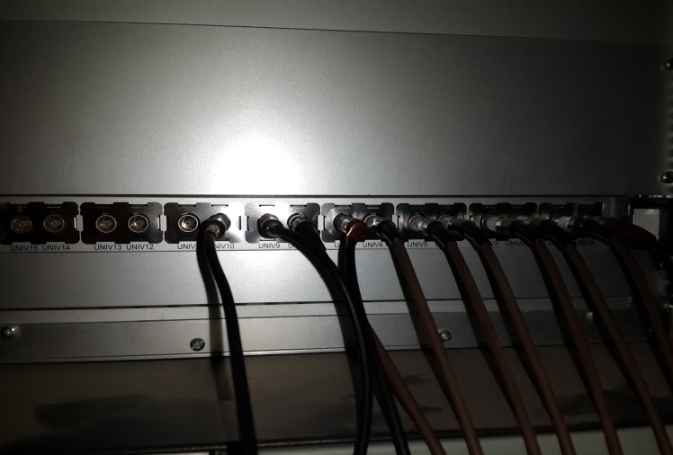
Timing Control System
SESAME
VME Crate from PSI
- One EVG card
- One EVR card
Timing Hardware
Timing Main OPI

Slide 20
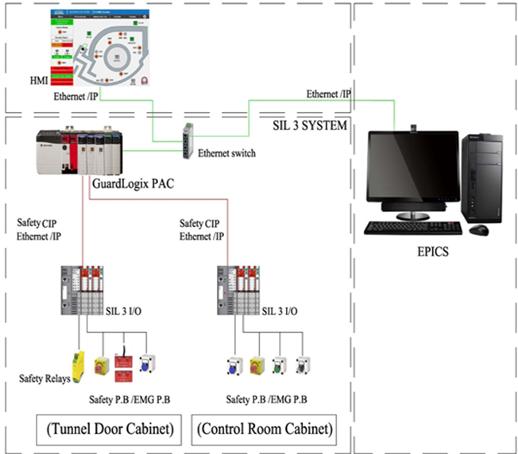
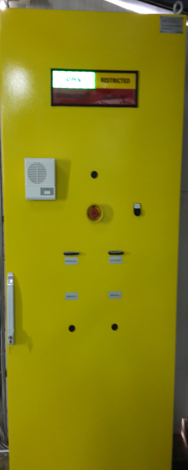
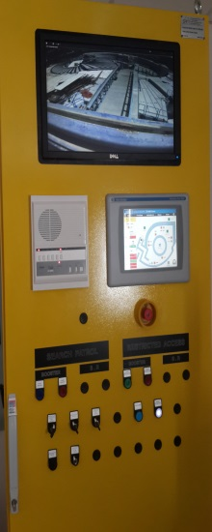
PSS Control System
SESAME
EtherIP driver/device
support module
interfaces Allen Bradley
Guard Logix safety PLC
via Ethernet to
EPICS IOC
The PSS IOC monitors the safety interlocks and showing them on the CSS
PSS Control Architecture
PSS Cabinets

Slide 21
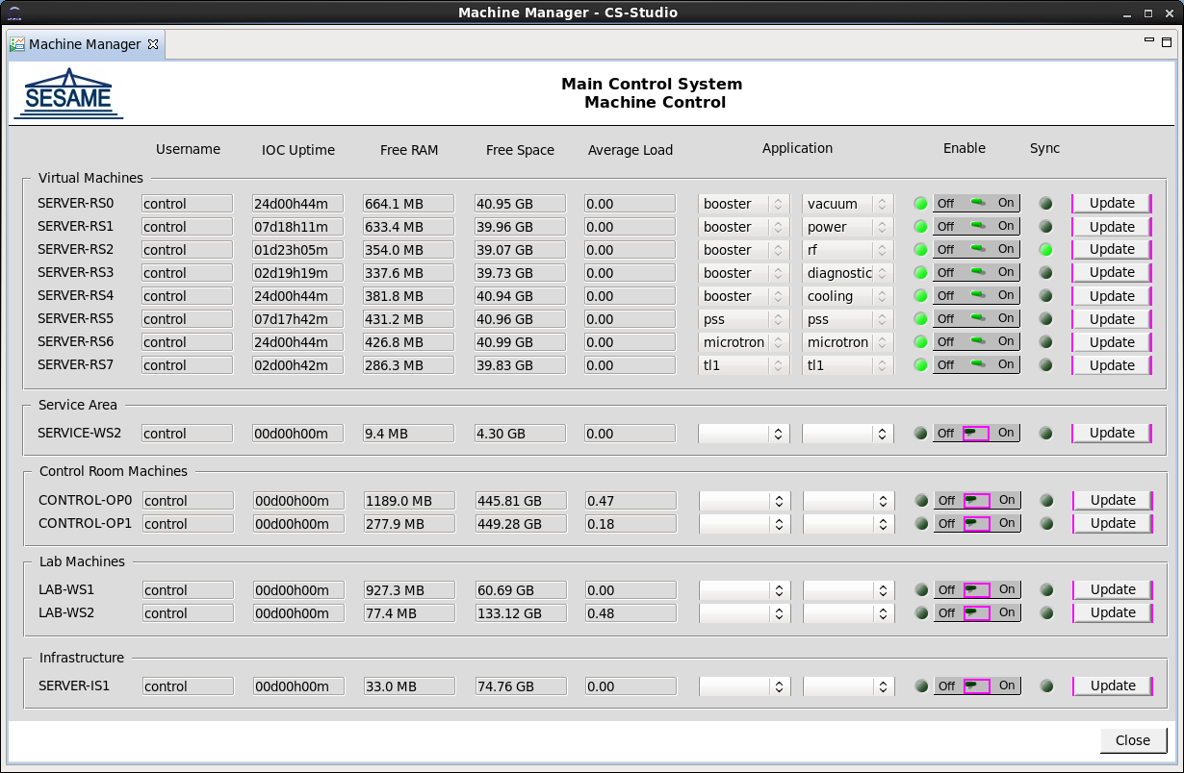
IOCs Development
SESAME
IOC Manager
- Enable/Disable the IOCs
- Synchronize IOCs with the
version control repository
- Monitor the uptime, free RAM,
free space and the average
load of the IOCs
- Manage the development
machines and other
infrastructure servers.
IOCs Manager OPI

Slide 22
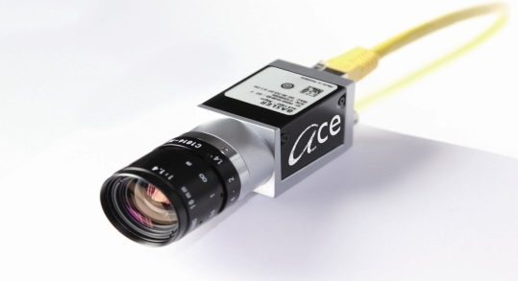
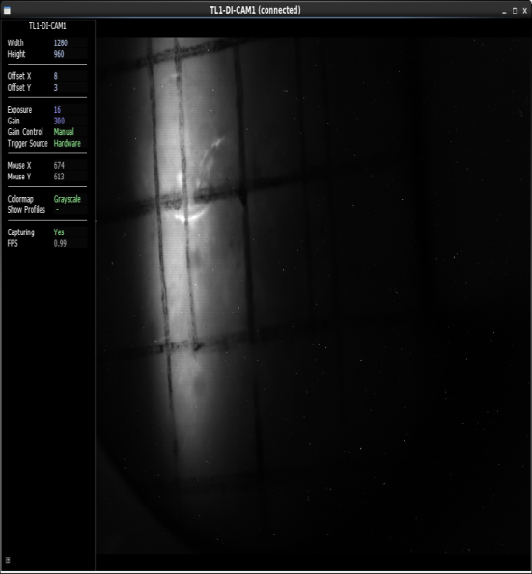
IOCs Development
SESAME
Basler GIGE Camera Driver
  - Ace acA1300-30gm GigE camera, no drivers available
- Purpose: Speed up scientific analysis, system integration
Needed image, gain, exposure, ROI, and trigger control
- Record types: Bi, bo, longin, longout, waveform
- Device support: Asynchronous processing (I/O thread)
- Driver support: One thread per device, message passing
- Device driver: Shared C++ libraries from Basler
Basler GIGE Camera
Beam Image

Slide 23

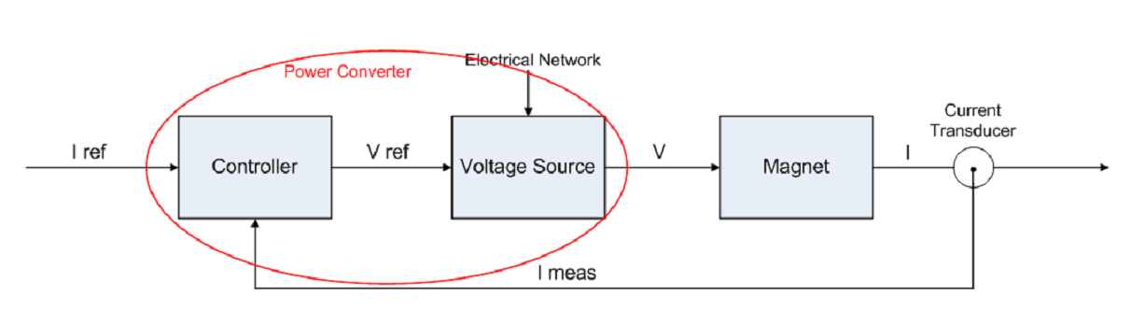
IOCs Development
SESAME
Storage Ring Power Supplies Control System
- Current controlled power supplies have 2 loops; a fast voltage feedback loop and
slow current feedback loop
- We bought a power supply which already contains the voltage feedback loop from
industry (Voltage Source)
- The current feedback loop is then implemented using PSI power supplies controllers

Slide 24
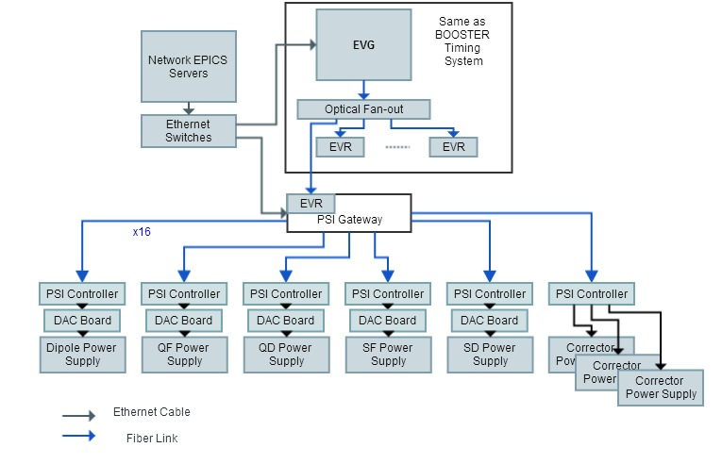
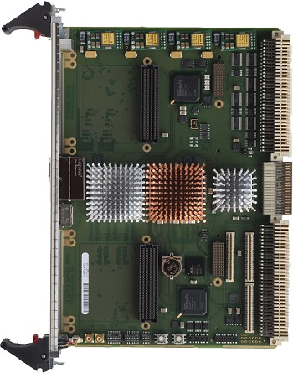
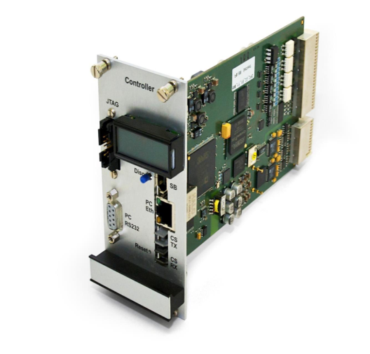
IOCs Development
SESAME
Storage Ring Power Supplies Control System
- Control room communicates with gateways
- Gateway distributes commands to power supplies
Reference current
Waveforms
Triggering and synchronization
Fast orbit feedback
Parameterization
Firmware upgrades
- Power supply drives magnet
Triggering and tracking repsonse and
jitter < 100us
Over damped response
Settling time within 50ppm < 1ms
Phase margin > 60
Architecture
Gateway
Controller

Slide 25
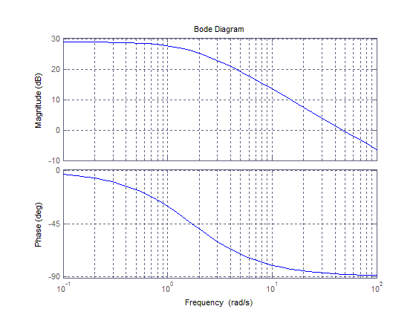
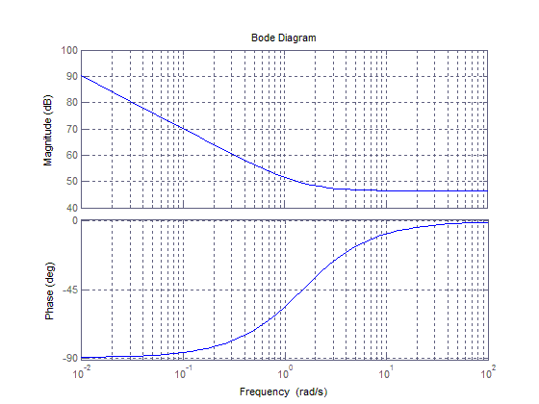
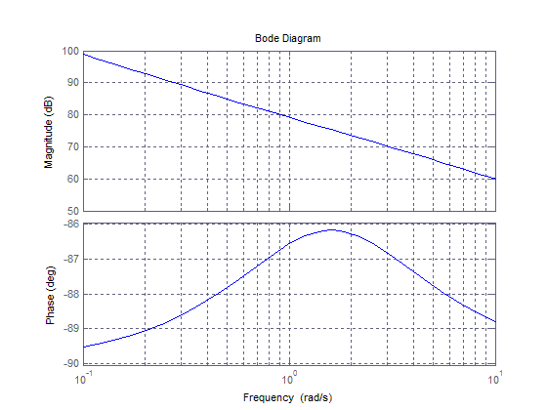
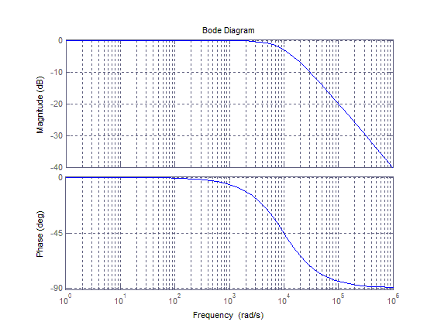
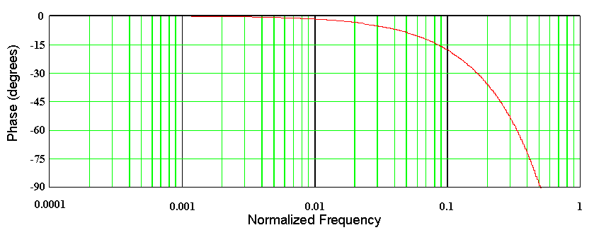
IOCs Development
SESAME
Storage Ring Power Supplies Control System
- Controller design requirements
- Overdamped response
- Settling time < 1ms
- Error band < 50ppm
- Phase margin > 60
- PI Controller design procedure
- Gp has dominant real pole
due to magnet
- Place zero to cancel dominant pole
- Place pole at origin
- Close the loop and set bandwidth
- Select sampling rate to achieve
phase margin
- Design equations:
- Ki = Wp, 10tau = 1ms, BW = 1/tau,
Kp = L.BW, Fs > 4Fc
-

Slide 26
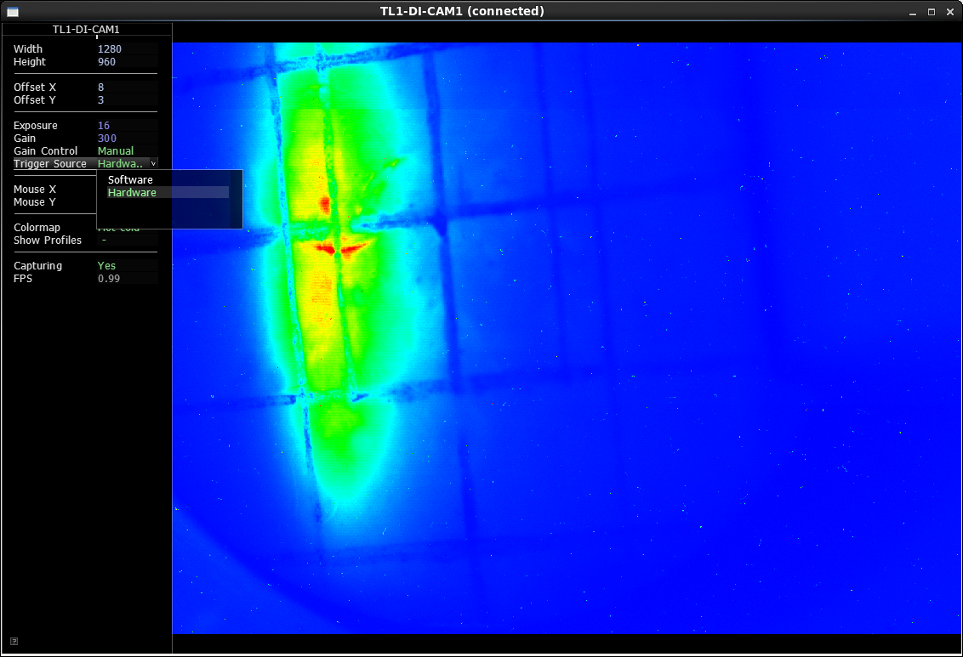

Clients Development
SESAME
Basler GIGE Camera Client
- Uses EPICS client framework
- Built using C, OpenGL, SDL and AntTweakBar
- Provide an interface to control basler camera parameters
such as: image size, offset, gain, exposure and trigger source
- Provides different color maps
Camera Client

Slide 27
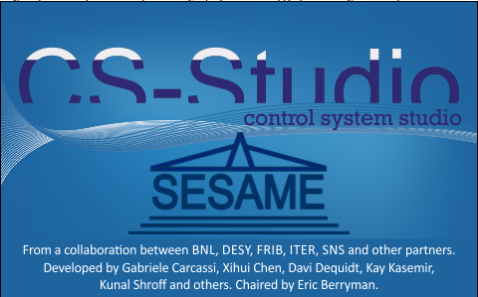

Clients Development
SESAME
SESAME CSS
- A custom SESAME build based on CSS v3.16
- Adding archiver and alarm handler to be integrated with the CSS
- CSS starts in run-time mode directly without showing
the eclipse development windows.
- Adding a thumbwheel function to the input
box widget to provide a compact fine-tunable
control to PVs

Slide 28


Clients Development
SESAME
SESAME CSS
- Showing screen names on windows title bar
- Only one instance of identical windows allowed at a time
- Adding window profiles saving and loading to arrange the CSS
workspace

Slide 29



Clients Development
SESAME
SESAME CSS Standards
All CSS screens follow a standard interface to ease and clarify
usage for operators
Examples:
- Color coding LEDs: green LEDs show on/off state, red LEDs show
interlock signals, yellow LEDs used for limit switches
- All reading fields have a gray background, while write-able fields
have a white background
- Tables are used throughout to monitor and control the devices

Slide 30


Clients Development
SESAME
BURT (Back Up and Restore Tool)
- Saves machine state and restores it later
- Uses a network file system to provide saved profiles on all
operator’s computers

Slide 31
Archive System
SESAME
Uses BEAUTY (Best Ever Archive Toolset Yet) Archiver
Integrates with CSS data browser
Has ability to specify a time interval
Show multiple PVs on the same plot
Uses free PostgreSQL DB
Installed on a virtual machine with access to EPICS IOCs
Only PV reading changes are recorded in the database
All PVs are monitored currently

Slide 32


Archive System
SESAME
Archiver Architecture
Vacuum readings data browser

Slide 33

Alarm Handler
SESAME
Uses BEAST (Best Ever Alarm System Toolkit) Alarm Handler
Integrates with CSS
Divides alarms per system
Alarms can be acknowledged
Monitors Real-time alarms
Uses PostgreSQL and Apache ActiveMQ
Installed on a virtual machine with access to EPICS IOCs
ANKA alarm creation server is used

Slide 34
Future Work
SESAME
Continue the work on the control system of the storage ring’s power supplies and other subsystems
Evaluation of a low cost, high performance controllers to be used
in the storage ring control system
Direct control of the timing system EVG and EVR cards by writing a driver for
them and run a soft IOC on one of the Linux workstations

Slide 35
Acknowledgement
SESAME
Mark Heron, Diamond Light Source, United Kingdom
Pascale Betinelli, SOLEIL Synchrotron, France
Elder Matias, Canadian Light Source, Canada
Igor Kriznar, ANKA, Germany
Babak Kalantari, PSI, Switzerland
Thank You

